Slide 1
Python - Syntax

Slide 2
print ("Hello, World!")
we can run the python code from the terminal or in the IDE
python3 test.py

Slide 3
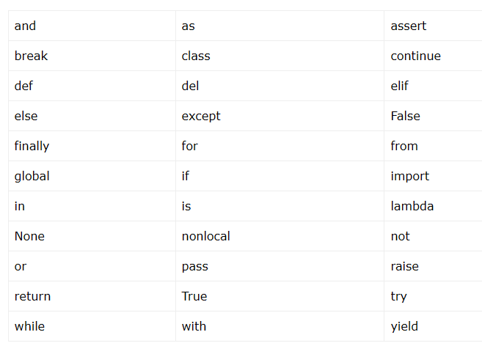
Python
Reserved
Words

Slide 4
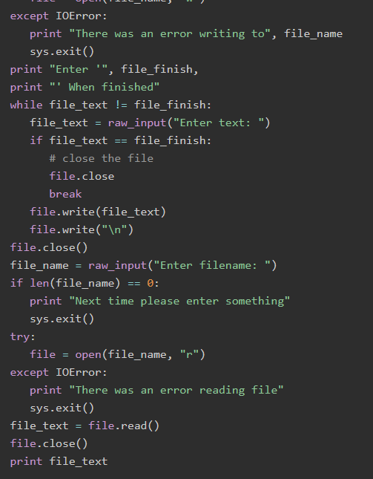
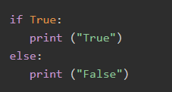
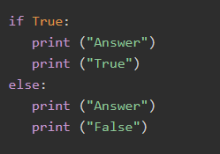
Python Lines and Indentation

Slide 5


Python Multi-Line Statements
line continuation character (\) to denote that the line should continue
Statements contained within the [], {}, or () brackets do not need to use the line continuation character. For example following statement works well in Python −

Slide 6
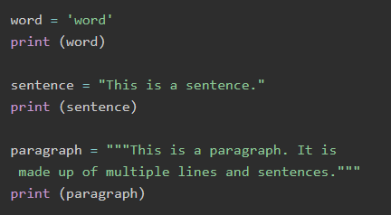
Quotations in Python
accepts single ('), double (") and triple (''' or """) quotes to denote string literals

Slide 7
Comments in Python
What are two ways you can write comments in a python?

Slide 8

Multiple Statements on a Single Line
The semicolon ( ; ) allows multiple statements on the single line given that neither statement starts a new code block.

Slide 9
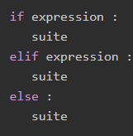
Multiple Statement Groups as Suites
A group of individual statements, which make a single code block are called suites in Python. Compound or complex statements, such as if, while, def, and class require a header line and a suite.

Slide 10
Python Variables
Python variables are the reserved memory locations used to store values with in a Python Program

Slide 11
Memory Addresses
Data items belonging to different data types are stored in computer's memory. Computer's memory locations are having a number or address, internally represented in binary form. Data is also stored in binary form as the computer works on the principle of binary representation.c
If you know the assembly language, you will covert these data items and the memory address, and give a machine language instruction. However, it is not easy for everybody. Language translator such as Python interpreter performs this type of conversion. It stores the object in a randomly chosen memory location. Python's built-in id() function returns the address where the object is stored.

Slide 12
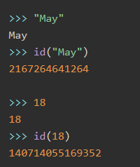

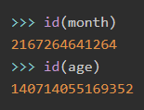
Once the data is stored in the memory, it should be accessed repeatedly for performing a certain process
In the above example, let us label the location of May as month, and location in which 18 is stored as age. Python uses the assignment operator (=) to bind an object with the label.

Slide 13

Creating Python Variables
Python variables do not need explicit declaration to reserve memory space or you can say to create a variable. A Python variable is created automatically when you assign a value to it. The equal sign (=) is used to assign values to variables.

Slide 14
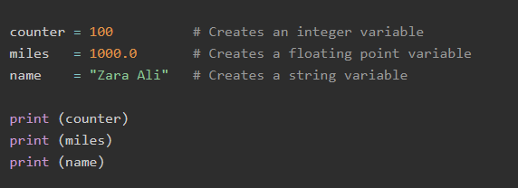

Example to Print Python Variables

Slide 15
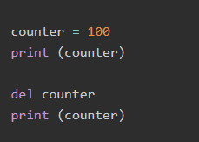


Deleting Python Variables
you can delete a single object or multiple objects by using the del statement. For example −

Slide 16
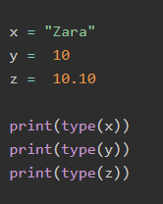

Getting Type of a Variable
You can get the data type of a Python variable using the python built-in function type() as follows.

Slide 17
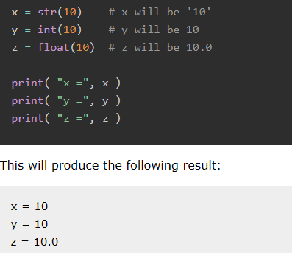
Casting Python Variables
You can specify the data type of a variable with the help of casting as follows:

Slide 18
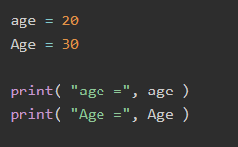
Case-Sensitivity of Python Variables

Slide 19
Python Variables - Multiple Assignment
>>> a=10
a=b=c=10
>>> print (a,b,c)
10 10 10
>>> a,b,c = 10,20,30
>>> print (a,b,c)
10 20 30

Slide 20
a,b,c = 1,2,"Zara Ali"
print (a)
print (b)
print (c)

Slide 21
naming Variables
counter = 100
_count = 100
name1 = "Zara"
name2 = "Nuha"
Age = 20
zara_salary = 100000
ageMike = “asdas”

Slide 22
invalid variable names:
1counter = 100
$_count = 100
zara-salary = 100000
ИМЯ = “aIBEK”

Slide 23
Once you use a variable to identify a data object, it can be used repeatedly without its id() value.
>>> width=10
>>> height=20
>>> area=width*height
>>> area
200
>>> perimeter=2*(width+height)
>>> perimeter
60

Slide 24
Use of variables is especially advantageous when writing scripts or programs
width = 10
height = 20
area = width*height
perimeter = 2*(width+height)
print ("Area = ", area)
print ("Perimeter = ", perimeter)

Slide 25
Local Variables
Local Variables are defined inside a function. We can not access variable outside the function.
A Python functions is a piece of reusable code and you will learn more about function
def sum(x,y):
sum = x + y
return sum
print(sum(5, 10))

Slide 26
Global Variables
Any variable created outside a function can be accessed within any function and so they have global scope.
x = 5
y = 10
def sum():
sum = x + y
return sum
print(sum())

Slide 27
Constants in Python
Python doesn't have any formally defined constants, However you can indicate a variable to be treated as a constant by using all-caps names with underscores. For example, the name PI_VALUE indicates that you don't want the variable redefined or changed in any way.
PI_VALUE = 3.14
y = 10
PI_VALUE += y
print(PI_VALUE )

